Slide 1
More on VC-dimension.
Lee-Ad Gottlieb

Slide 2
VC-dimension
The infinite set of (bi-directional) lines can shatter some set of 3 points in 2D

Slide 3
VC-dimension
There does not exist any set of four points which can be shattered by the infinite set of lines.
A
B

Slide 4
Balls in 2D
Claim: VC-dimension of infinite set of uni-directional balls (inside=red) in 2D is 3. Lower-bound:

Slide 5
Balls in 2D
Proof: Upper-bound
A. If one point is in the convex hull of the others, must have same label.
B. If points are in general position, find opposite pairs. There must be a circle containing each pair
But the symmetric difference of two circles is at most 2

Slide 6
VC-dimension
Claim: The set of d-1 dimensional hyperplanes has VC-dimension d+1 on R^{d}.
2D points
3D points

Slide 7





VC-dimension
Lower-bound:
The set of d-1 dimensional hyperplanes can shatter d+1 points in R^{d}.
Proof: $\vec{0}, e_{1},e_{2},…, e_{d}$
$$e_{2}=(0,1,0)$$
$$e_{3}=(0,0,1)$$
$$\vec{0}=(0,0,0)$$
$$e_{1}=(1,0,0)$$

Slide 8
VC-dimension
Upper-bound:
The set of d-1 dimensional hyperplanes cannot shatter d+2 points in R^{d}.
Proof:
Radon’s theorem: any set of d+2 points in R^{d} can be partitioned into two disjoint sets whose convex hulls intersect.
The intersection point can’t be both blue and red.

Slide 9


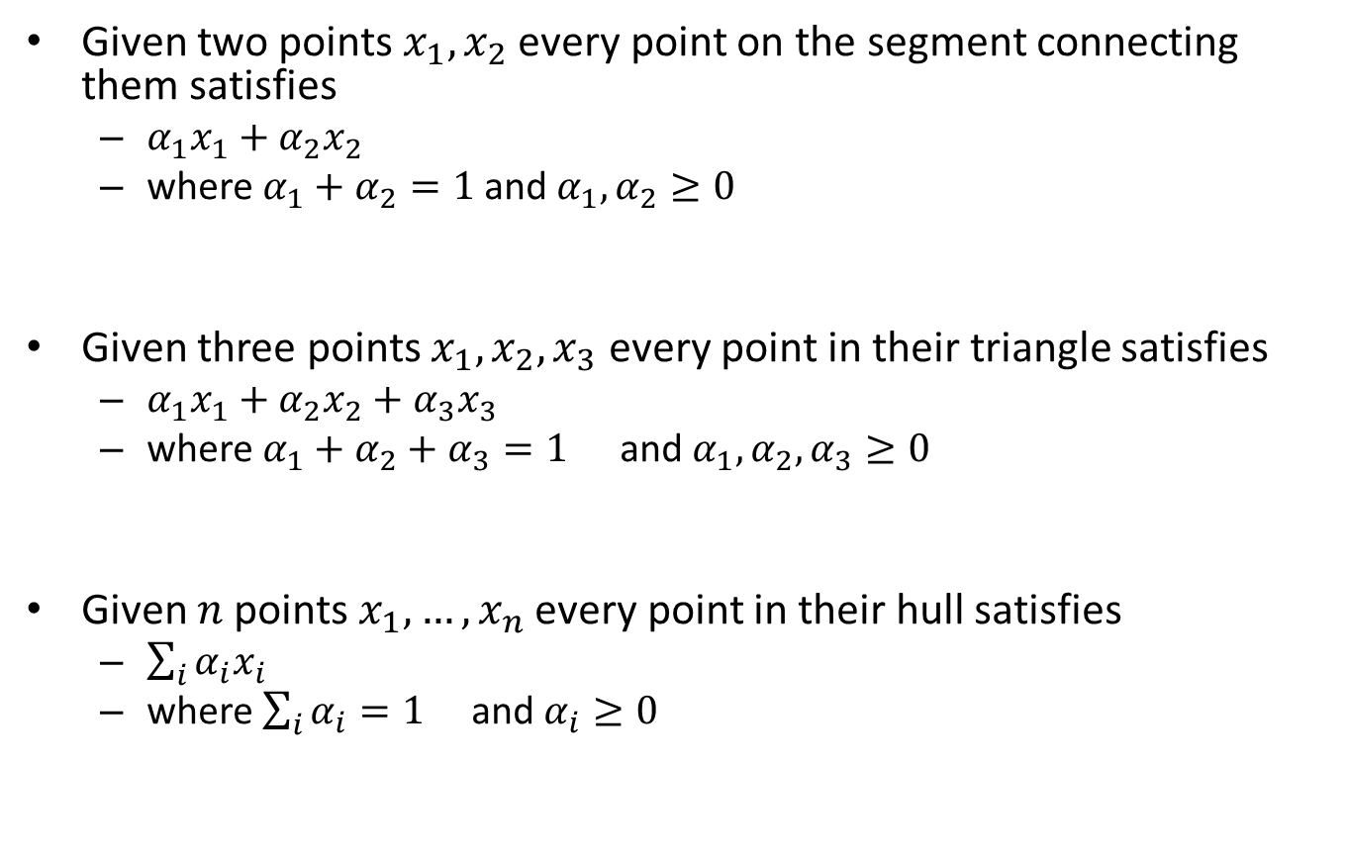



Background: convex hull
Given two points $x_{1},x_{2}$ every point on the segment connecting them satisfies
$α_{1}x_{1}+α_{2}x_{2}$
where $α_{1}+α_{2}=1$and $α_{1},α_{2}≥0$
Given three points $x_{1},x_{2},x_{3}$ every point in their triangle satisfies
$α_{1}x_{1}+α_{2}x_{2}+α_{3}x_{3}$
where $α_{1}+α_{2}+α_{3}=1$ and $α_{1},α_{2},α_{3}≥0$
Given $n$ points $x_{1},…,x_{n}$ every point in their hull satisfies
$\sum_{i}{α_{i}x_{i}}$
where $\sum_{i}{α_{i}}=1$ and $α_{i}≥0$
$$x_{2}$$
$$x_{1}$$
$$x_{2}$$
$$x_{1}$$
$$x_{3}$$

Slide 10
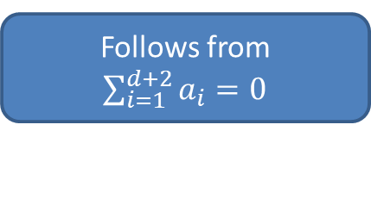
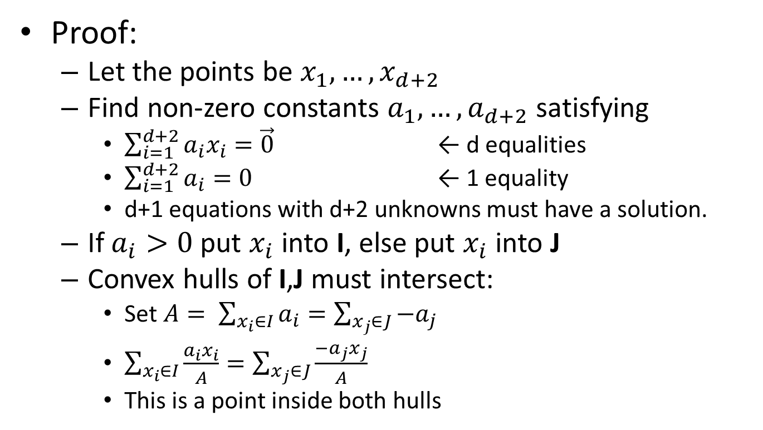
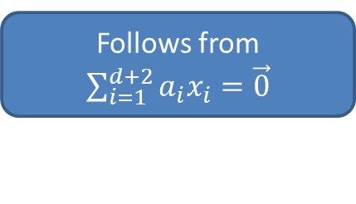
Radon’s theorem
Proof:
Let the points be $x_{1},…,x_{d+2}$
Find non-zero constants $a_{1},…,a_{d+2}$ satisfying
$\sum_{i=1}^{d+2}{a_{i}x_{i}=\vec{0}}$ ← d equalities
$\sum_{i=1}^{d+2}{a_{i}=0}$ ← 1 equality
d+1 equations with d+2 unknowns must have a solution.
If $a_{i}>0$ put $x_{i}$ into I, else put $x_{i}$ into J
Convex hulls of I,J must intersect:
Set $A= \sum_{x_{i}∈I}{a_{i}=\sum_{x_{j}∈J}{−a_{j}}}$
$\sum_{x_{i}∈I}{\frac{a_{i}x_{i}}{A}}=\sum_{x_{j}∈J}{\frac{{−a}_{j}x_{j}}{A}}$
This is a point inside both hulls
Follows from $\sum_{i=1}^{d+2}{a_{i}=0}$
Follows from $\sum_{i=1}^{d+2}{a_{i}x_{i}=\vec{0}}$

Slide 11

Planes with margin
A hyperplane with margin $γ$ can shatter only O($R/γ)2$points within radius R, irrespective of the dimension.

Slide 12
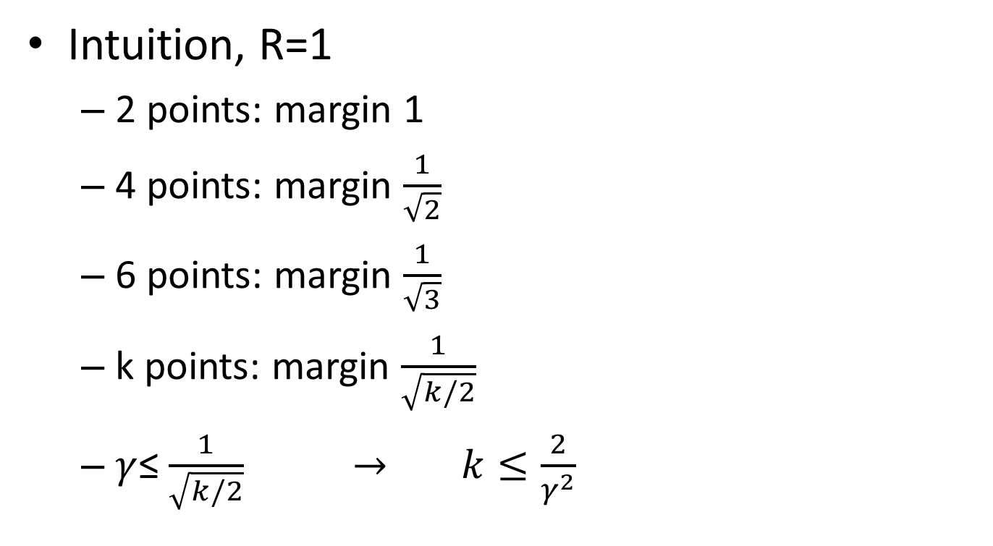
Planes with margin
Intuition, R=1
2 points: margin 1
4 points: margin $\frac{1}{\sqrt{2}}$
6 points: margin $\frac{1}{\sqrt{3}}$
k points: margin $\frac{1}{\sqrt{k/2}}$
$γ$≤ $\frac{1}{\sqrt{k/2}}$ $→$ $k≤\frac{2}{γ^{2}}$
1
1
1

Slide 13
Union of hypotheses
What about objects that are the union or intersection of simple rules?

Slide 14
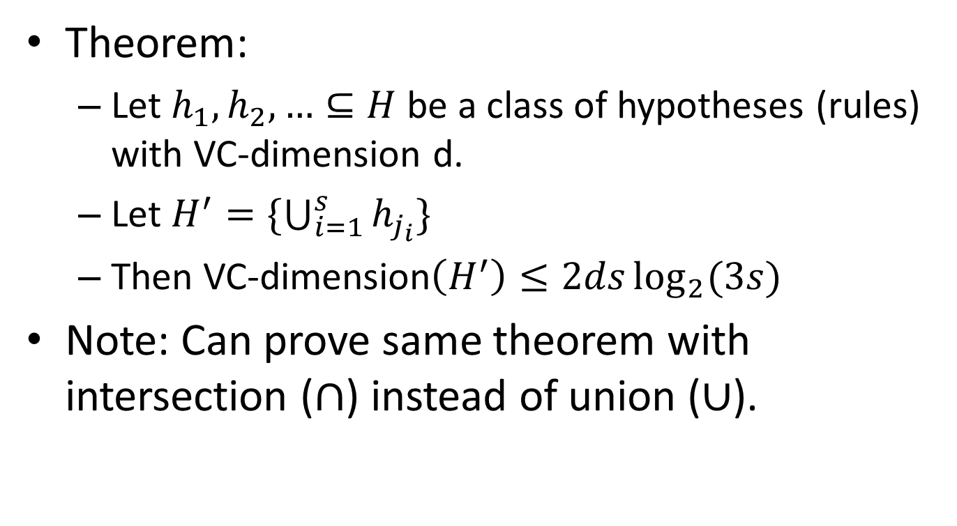
Union of hypotheses
Theorem:
Let $h_{1},h_{2},…⊆H$ be a class of hypotheses (rules) with VC-dimension d.
Let $H^{′}=\{\bigcup_{i=1}^{s}{h_{j_{i}}\}}$
Then VC-dimension$\left(H^{′}\right)≤2ds\log_{2}{(3s)}$
Note: Can prove same theorem with intersection ($∩$) instead of union ($∪$).

Slide 15

Union of hypotheses
Proof:
For any point-set P of size n
$$Π\left(H^{′},P\right)≤{\left[Π\left(H,P\right)\right]}^{s}≤{\left({en}/d\right)}^{ds}$$
Number of possible labellings in H, raised to the s
Sauer’s lemma

Slide 16
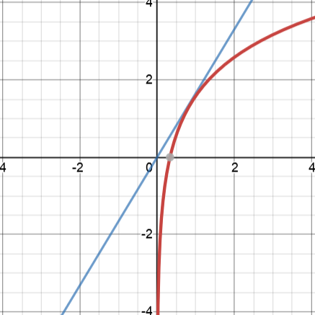
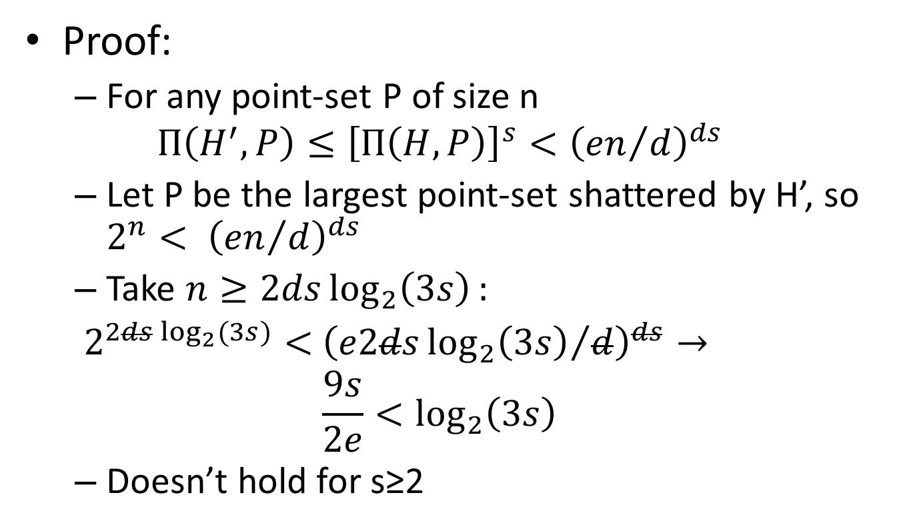
Union of hypotheses
Proof:
For any point-set P of size n
$$Π\left(H^{′},P\right)≤{\left[Π\left(H,P\right)\right]}^{s}<{\left({en}/d\right)}^{ds}$$
Let P be the largest point-set shattered by H’, so $2^{n}< {\left({en}/d\right)}^{ds}$
Take $n≥2ds\log_{2}\left(3s\right):$
$2^{2ds\log_{2}{(3s)}}<$ ${\left({e2ds\log_{2}\left(3s\right)}/d\right)}^{ds}→$
$$\frac{9s}{2e}<\log_{2}\left(3s\right)$$
Doesn’t hold for s≥2

